Slide 1
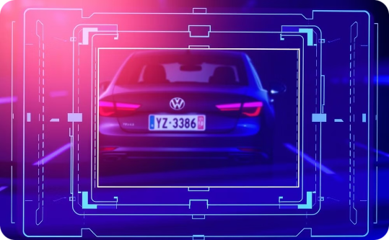
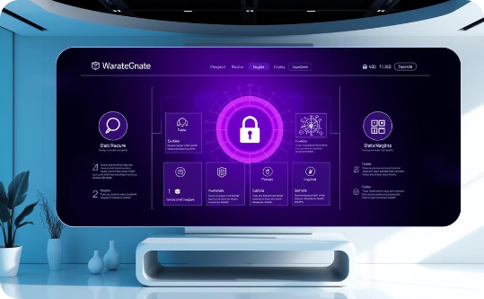
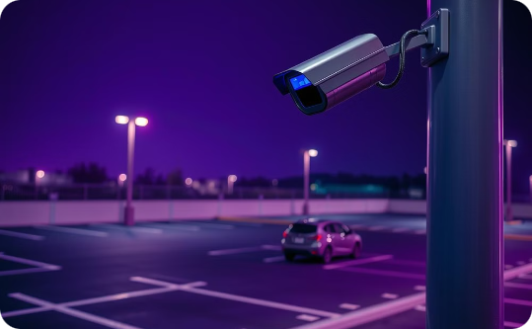
Parking Management Project: Vehicle Information System
License Plate Recognition
Efficient Data Management
Enhanced Security
Enables quick vehicle lookup, significantly improving efficiency.
Streamlines parking operations through organized and accessible data.
Improves security and accountability within parking facilities.
Our Vehicle Information System (VIS) enhances parking operations by providing quick vehicle lookup, improving operational efficiency, and ensuring a safer, more organized parking environment.

Slide 2
Problem Statement: Inefficient Parking Management
Manual Record-Keeping
Security Concerns
Lack of Real-Time Data
Manual record-keeping is time-consuming and error-prone, leading to inefficiencies in tracking vehicles. The average search time for a vehicle is 15 minutes manually versus less than 10 seconds with the proposed system. Internal Time and Motion Study, Jan 2024.
Difficulties in tracking vehicles result in unauthorized parking and security concerns related to vehicle theft and vandalism. The lack of real-time data further compounds these issues, making it challenging to manage parking spaces effectively.
The absence of real-time data on parking space availability hinders efficient parking management. This results in wasted time for users searching for parking spots and operational inefficiencies for the facility.

Slide 3
Proposed Solution: Vehicle Information System (VIS)
1
Centralized Database
2
User-Friendly Interface
A centralized database stores vehicle information, including license plate, owner, and vehicle type. This ensures easy access and management of all vehicle records in one place.
The interface allows users to register new vehicles and update existing records. Fast and accurate search functionality is achieved through license plate numbers, enhancing user experience.
3
System Integration
4
Data Security
Integration with parking access control systems, such as automated gates, enables seamless entry and exit. Real-time reporting on parking occupancy and utilization rates provides valuable insights for management.
Data encryption and access controls ensure data security, protecting sensitive information from unauthorized access. The estimated implementation cost is $50,000, with annual maintenance of $5,000.

Slide 4
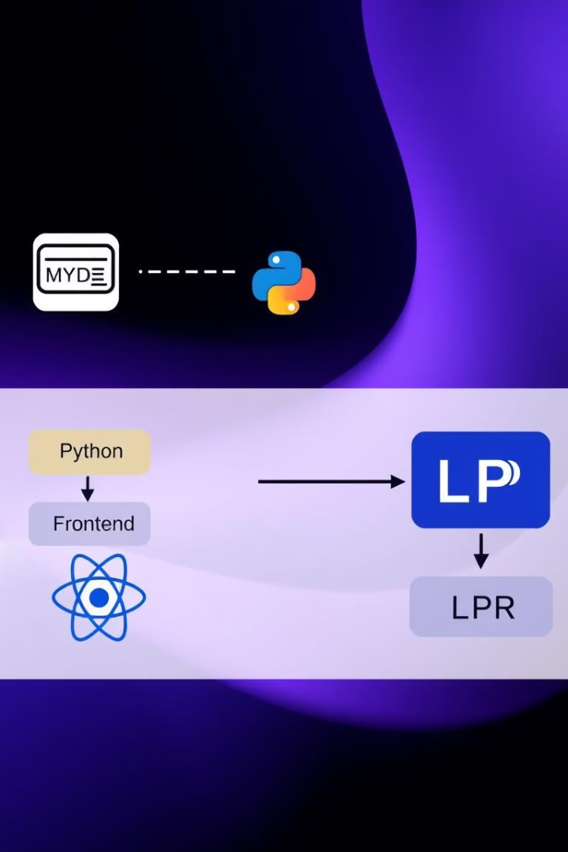




System Architecture
Database: MySQL
MySQL is used for storing vehicle and user data, scalable to handle over 1 million records, ensuring long-term reliability and performance.
Backend: Python (Flask)
Python (Flask) facilitates API development and data processing, providing a robust and efficient backend framework for the system.
Frontend: React
React enables a responsive and intuitive user interface, enhancing user experience across different devices and platforms.
LPR Integration
Integration with OpenCV and Tesseract OCR for automated plate reading boasts 95% accuracy, significantly improving vehicle identification.

Slide 5





Key Features and Functionality
Vehicle Registration
License Plate Search
User Management
Reporting and Analytics
Capture vehicle details including license plate, make, model, color, and owner details for comprehensive record-keeping.
Quickly find vehicle information using the license plate number, enabling efficient vehicle tracking and management.
Control access levels and permissions for different users, such as admins and security personnel, ensuring data security.
Generate reports on parking occupancy, peak hours, and unauthorized vehicles, providing insights for better decision-making.

Slide 6
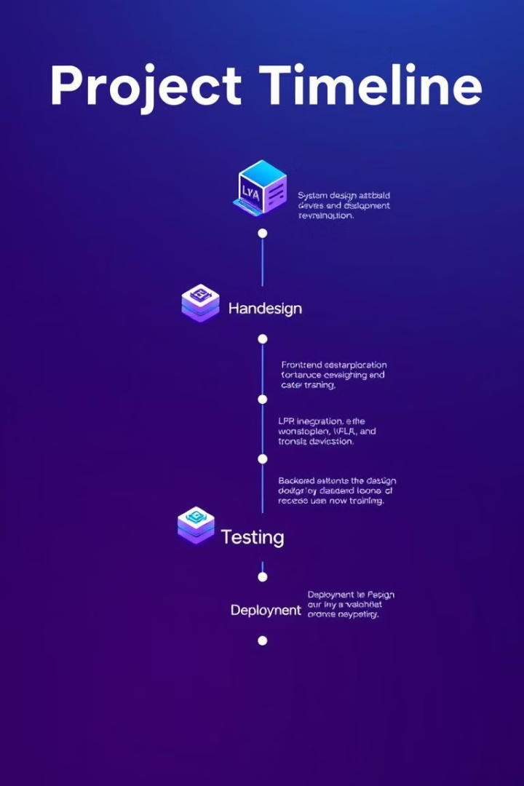
Implementation Plan
1
Phase 1 (2 Months)
System design and database setup to establish a solid foundation for the VIS implementation.
2
Phase 2 (3 Months)
Frontend and backend development to create a user-friendly interface and robust data processing capabilities.
3
Phase 3 (1 Month)
LPR integration and testing to automate license plate recognition and improve vehicle identification accuracy.
4
Phase 4 (1 Month)
User training and system deployment to ensure smooth adoption and utilization of the VIS.
Total implementation time is estimated at 7 months, with a team including 1 Project Manager, 2 Software Developers, 1 Database Administrator, and 1 QA Tester.

Slide 7
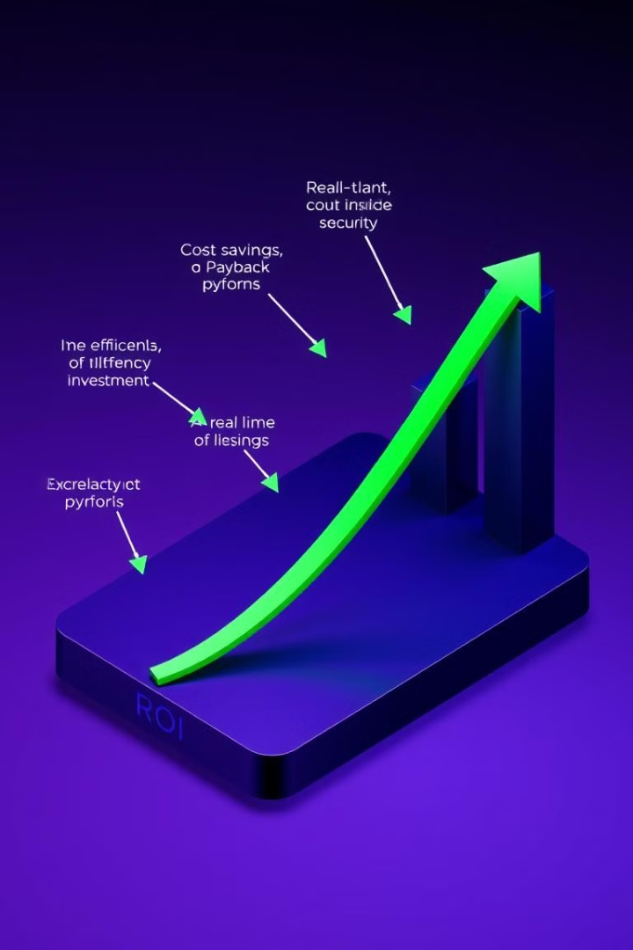
Benefits and ROI
Improved Efficiency
Improved parking efficiency and reduced search times by 90%, enhancing user experience and facility operations.
Enhanced Security
Enhanced security and accountability deter unauthorized parking, ensuring a safer parking environment for users and vehicles.
Real-Time Insights
Real-time data insights for better parking management decisions, enabling optimized space utilization and revenue generation.
Cost Savings
Cost savings on manual labor and administrative overhead, estimated at $20,000 per year, improving the financial performance of the facility.
Payback period is estimated at 2.5 years, making VIS a financially sound investment for parking facilities, increasing revenue through efficient parking space utilization (est. 15% increase).

Slide 8

Conclusion and Next Steps
The Vehicle Information System (VIS) offers a comprehensive solution to address the challenges of parking management, providing improved efficiency, enhanced security, and real-time insights.
Call to action: Secure funding and begin implementation to transform parking operations and user experiences. Next steps include conducting a pilot test at a smaller parking facility, gathering user feedback, and refining the system based on feedback.
Thank you & Q/A. Implementing the Vehicle Information System will elevate your parking management to the next level.

